Slide 1
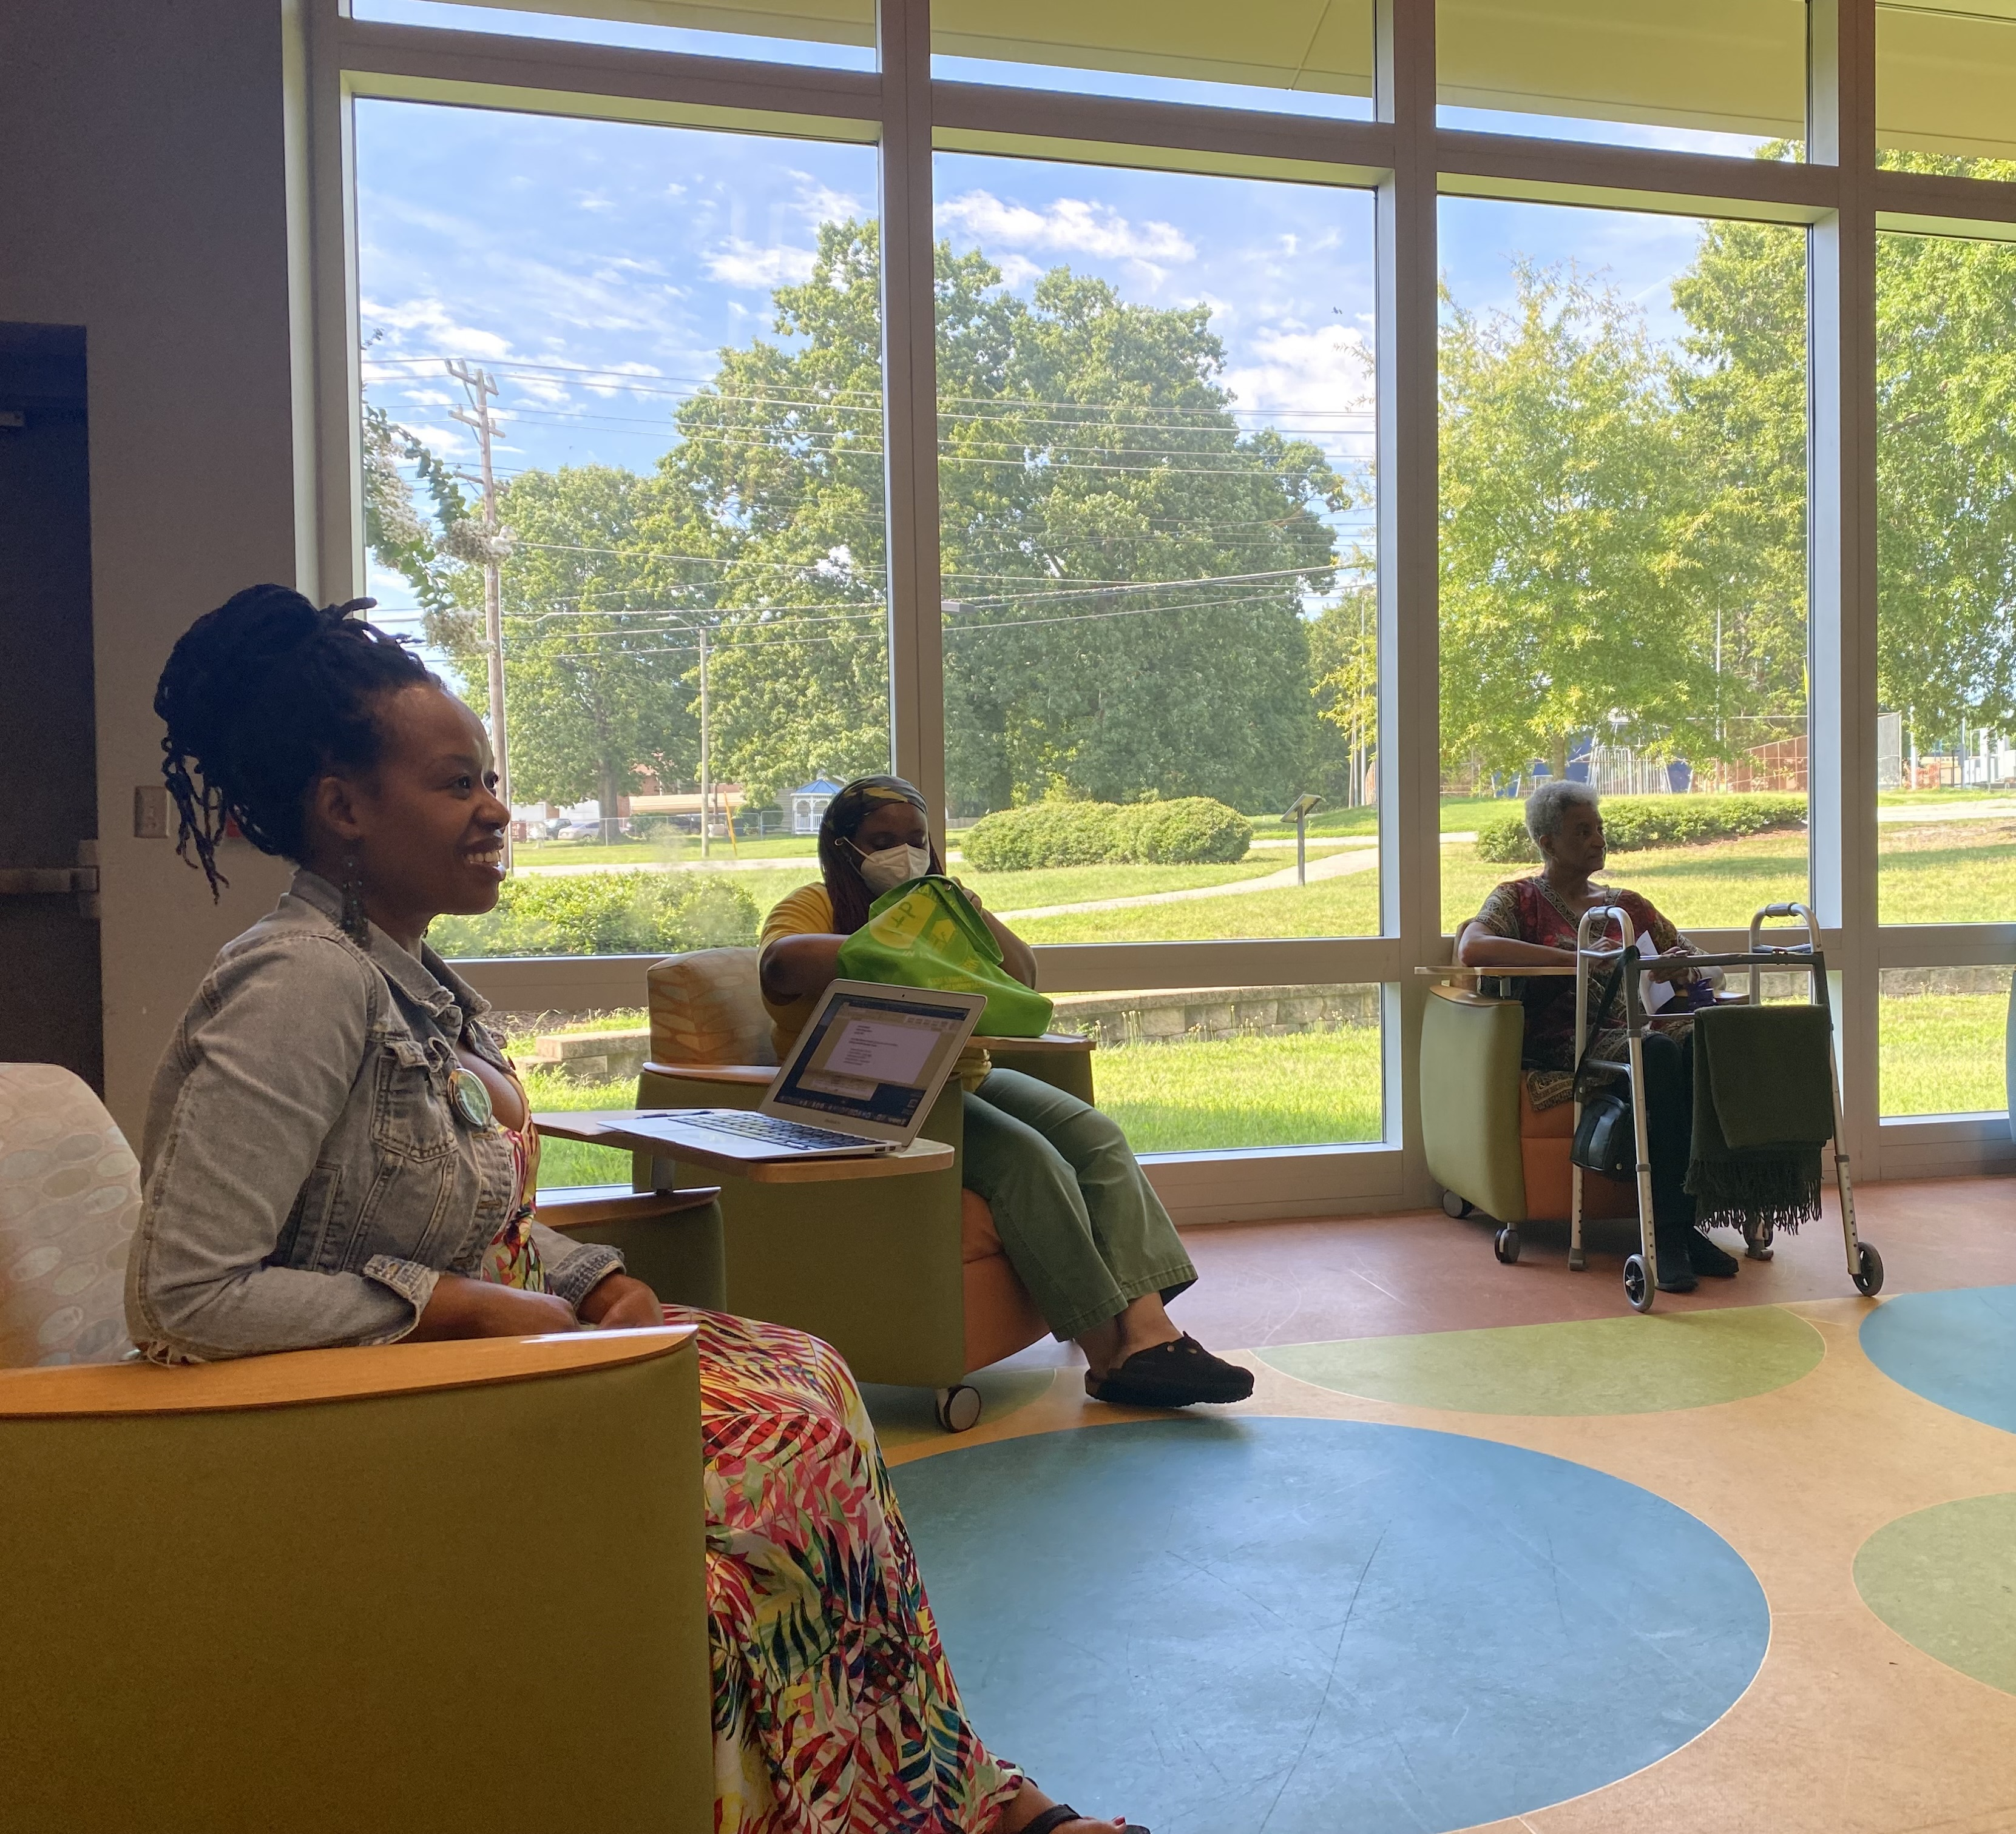
Community Elevation Grant Data Analysis
August 2022

Slide 2
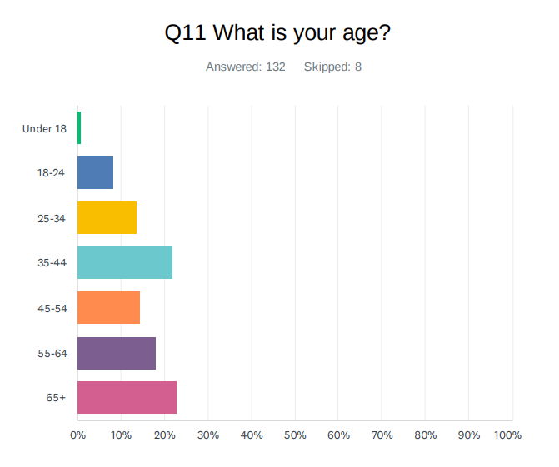
Who Responded?
23% - 65+
22% - 35-44
18% - 55-64

Slide 3
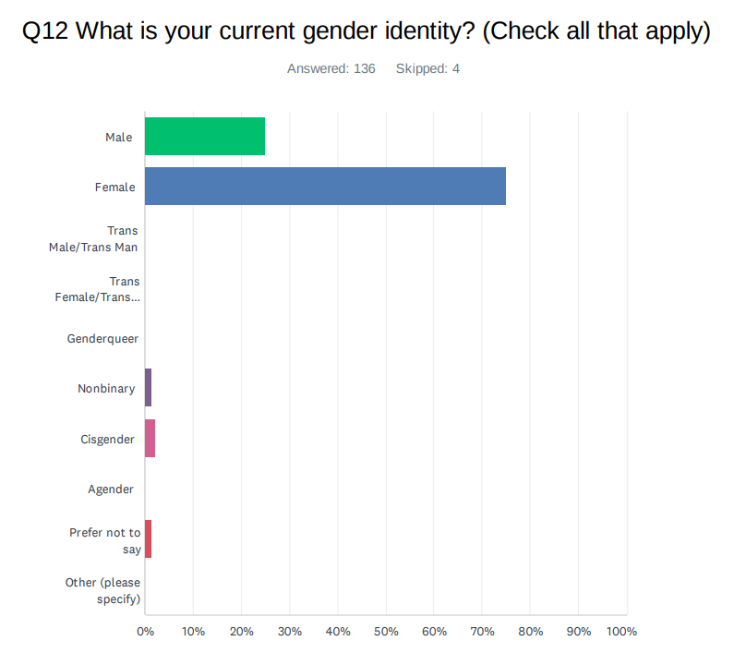
Who Responded?
25% Male
75% Female

Slide 4
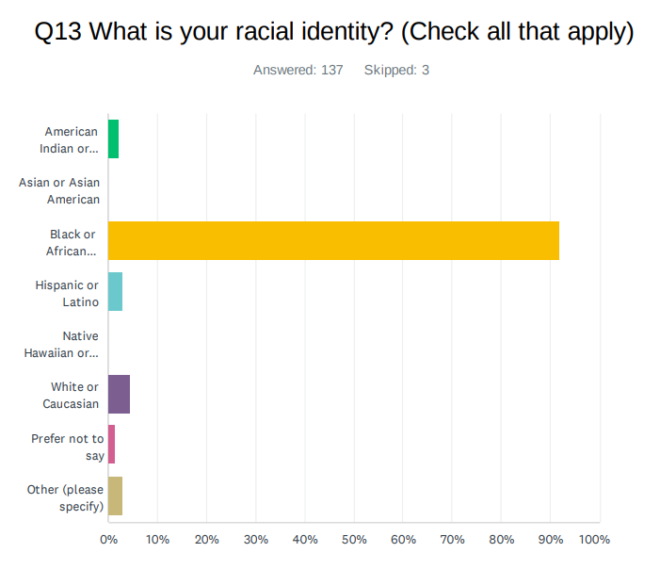
Who Responded?
92% Black or African American

Slide 5
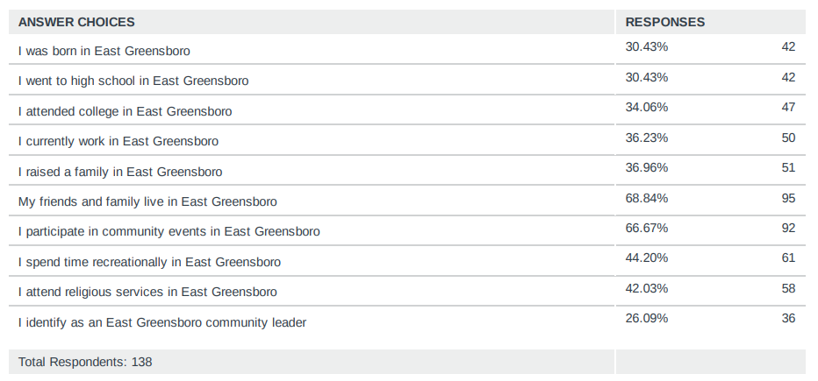
Who Responded?
Q4 How do you participate in your East Greensboro community?
Select all that apply.
Friends & Family
Community Events

Slide 6
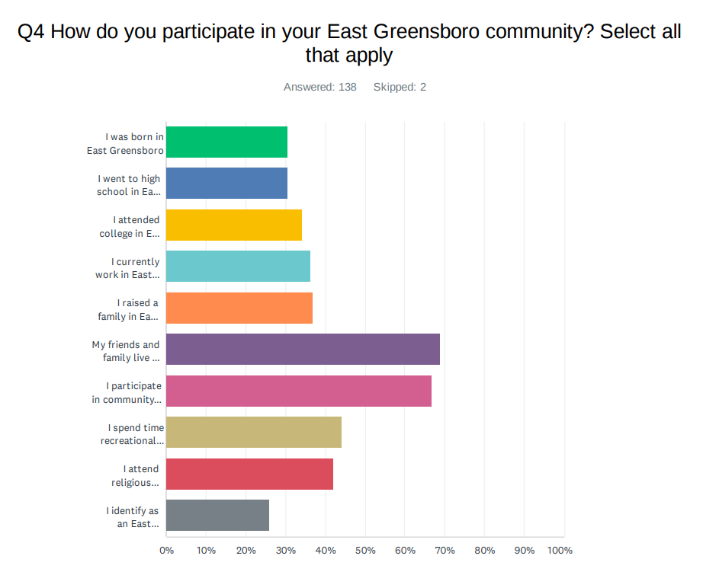
Who Responded?
Friends & Family
Community Events

Slide 7
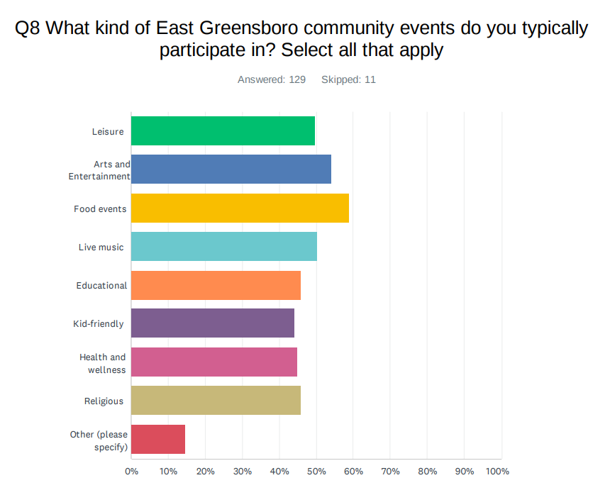
Who Responded?
Respondents participate in all kinds of community events

Slide 8
Q1: What do you feel is the biggest challenge facing neighborhoods in East Greensboro?
“lack” appears 38 times
“crime” appears 22 times; “violence” appears 10 times; “safety” appears 6 times; “gun control” or “gun violence” shows up 5 times
“food” related responses (food insecurity, food deserts, food options, etc.) appear 20 times
“resources” appears 19 times
“housing” or “houses” appears 14 times
“poverty” appears 11 times
“drugs” appears 8 times
NARRATIVE SUMMARY: Residents and friends of East Greensboro feel that there is a general lack of resources that impacts quality of life in the area. In addition to lack, crime, poverty, housing, and food quality, and job shortages continue to be pervasive issues.

Slide 9
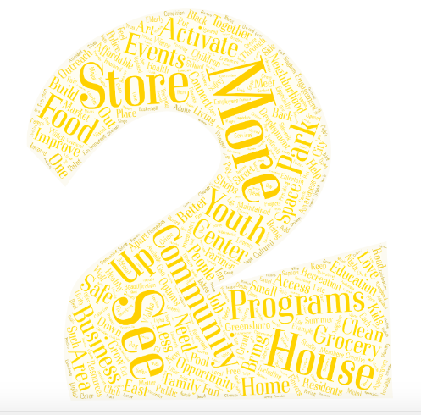
Q2: What are some ways that you would like to see your East Greensboro community grow?
“More” appears 60 times
“Community” appears 42 times
“Programs” appears 18 times
“House” or “housing” appears 15 times
“Store” or “Business” appears 13 times
“Youth” appears 11 times
“Grocery” appears 11 times
NARRATIVE SUMMARY: The use of the word “more” indicates that while there may be some resources and interventions available to East Greensboro residents, there is a need for additional support. Community was emphasized by survey participants, as well as the need for programs that address the challenges that were articulated in Q1.

Slide 10
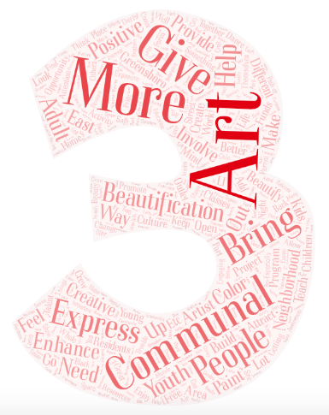
Q3: How do you think the arts could enhance the East Greensboro community?
“Community” or “communal” appears 40 times
“More” appears 23 times
“People” appears 22 times
“Bring” appears 21 times
“Give” appears 15 times
“Express” appears 12 times
“Beautification” and “positive” each appear 10 times
“Neighborhood” appears 9 times
“Help” and “Enhance” each appear 9 times
NARRATIVE SUMMARY: There is a strong desire for art projects that cultivate community. Respondents repeatedly shared the need for residents to express themselves in various ways, and for creative projects that bring beauty and positivity to their neighborhoods.

Slide 11
Q5: In ONE word, how do you feel about your East Greensboro community?
“Love” appears 11 times
“Good,” “hope,” “grow,” and “home” each appear 7 times
“Proud,” “potential,” and “help” each appear 4 times.
The remaining words appear 3 times or less, revealing that there is a wide range of feelings associated with East Greensboro.
NARRATIVE SUMMARY: The feelings that respondents have about East Greensboro vary widely. Some words, like “ghetto,” “unsafe,” “disappointed,” “poor,” and “oppression” have a clearly negative connotation. Most feelings, however, are overwhelmingly positive – “growing,” “proud,” “resilient,” “striving,” “revolutionary,” etc.

Slide 12
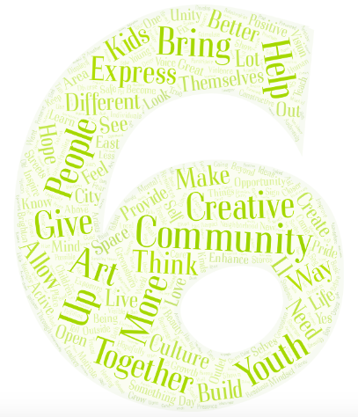
Q6: How do you think the arts and creativity can make a difference in your East Greensboro community?
“Community” appears 28 times
“People” appears 24 times
“Together” appears 15 times
“Express” appears 12 times
“Youth” appears 11 times
Words like “hope,” “opportunity, “better,” give,” and “help” appear 38 times
NARRATIVE SUMMARY: Like previous questions, respondents emphasized the potential for the arts to contribute to the elevation of the community in various ways. Community continues to be a prominent theme, evidenced by the repeated use of “people” and “together” in responses. There is also a desire for opportunities for residents to express themselves, and a hope for youth-centered projects.

Slide 13
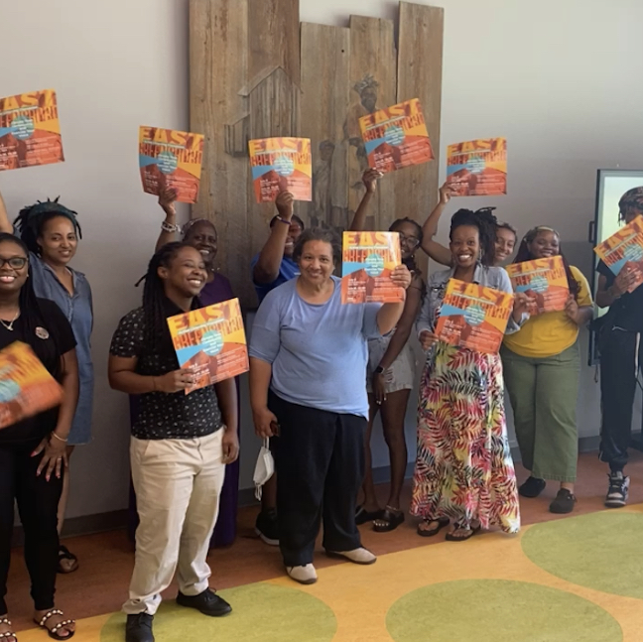
CONCLUSION
Respondents want arts projects that bring people together and that contribute to mental/emotional and aesthetic improvements for East Greensboro.
Respondents also want programs that connect people (especially youth) to resources – job opportunities, healthy food options, affordable housing, etc.

Slide 14
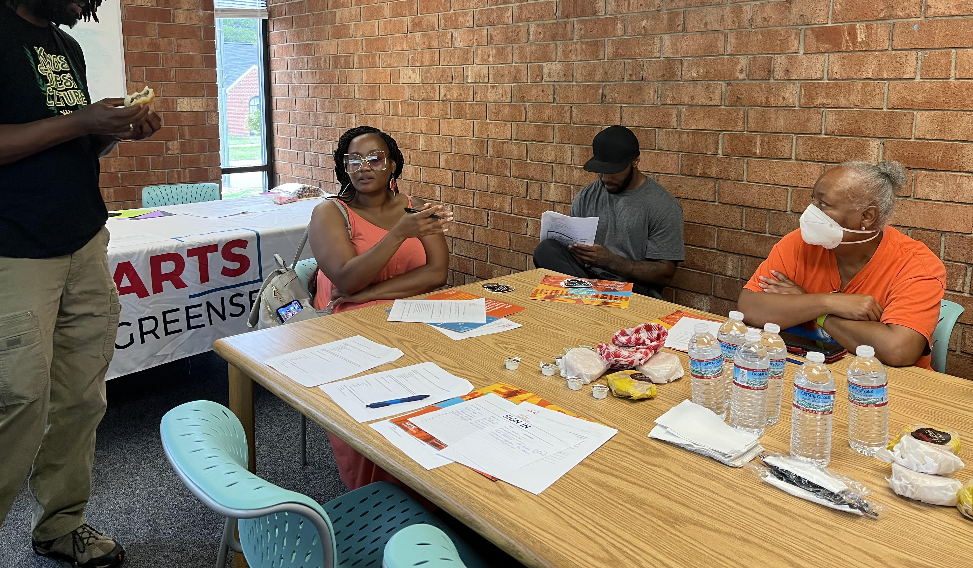
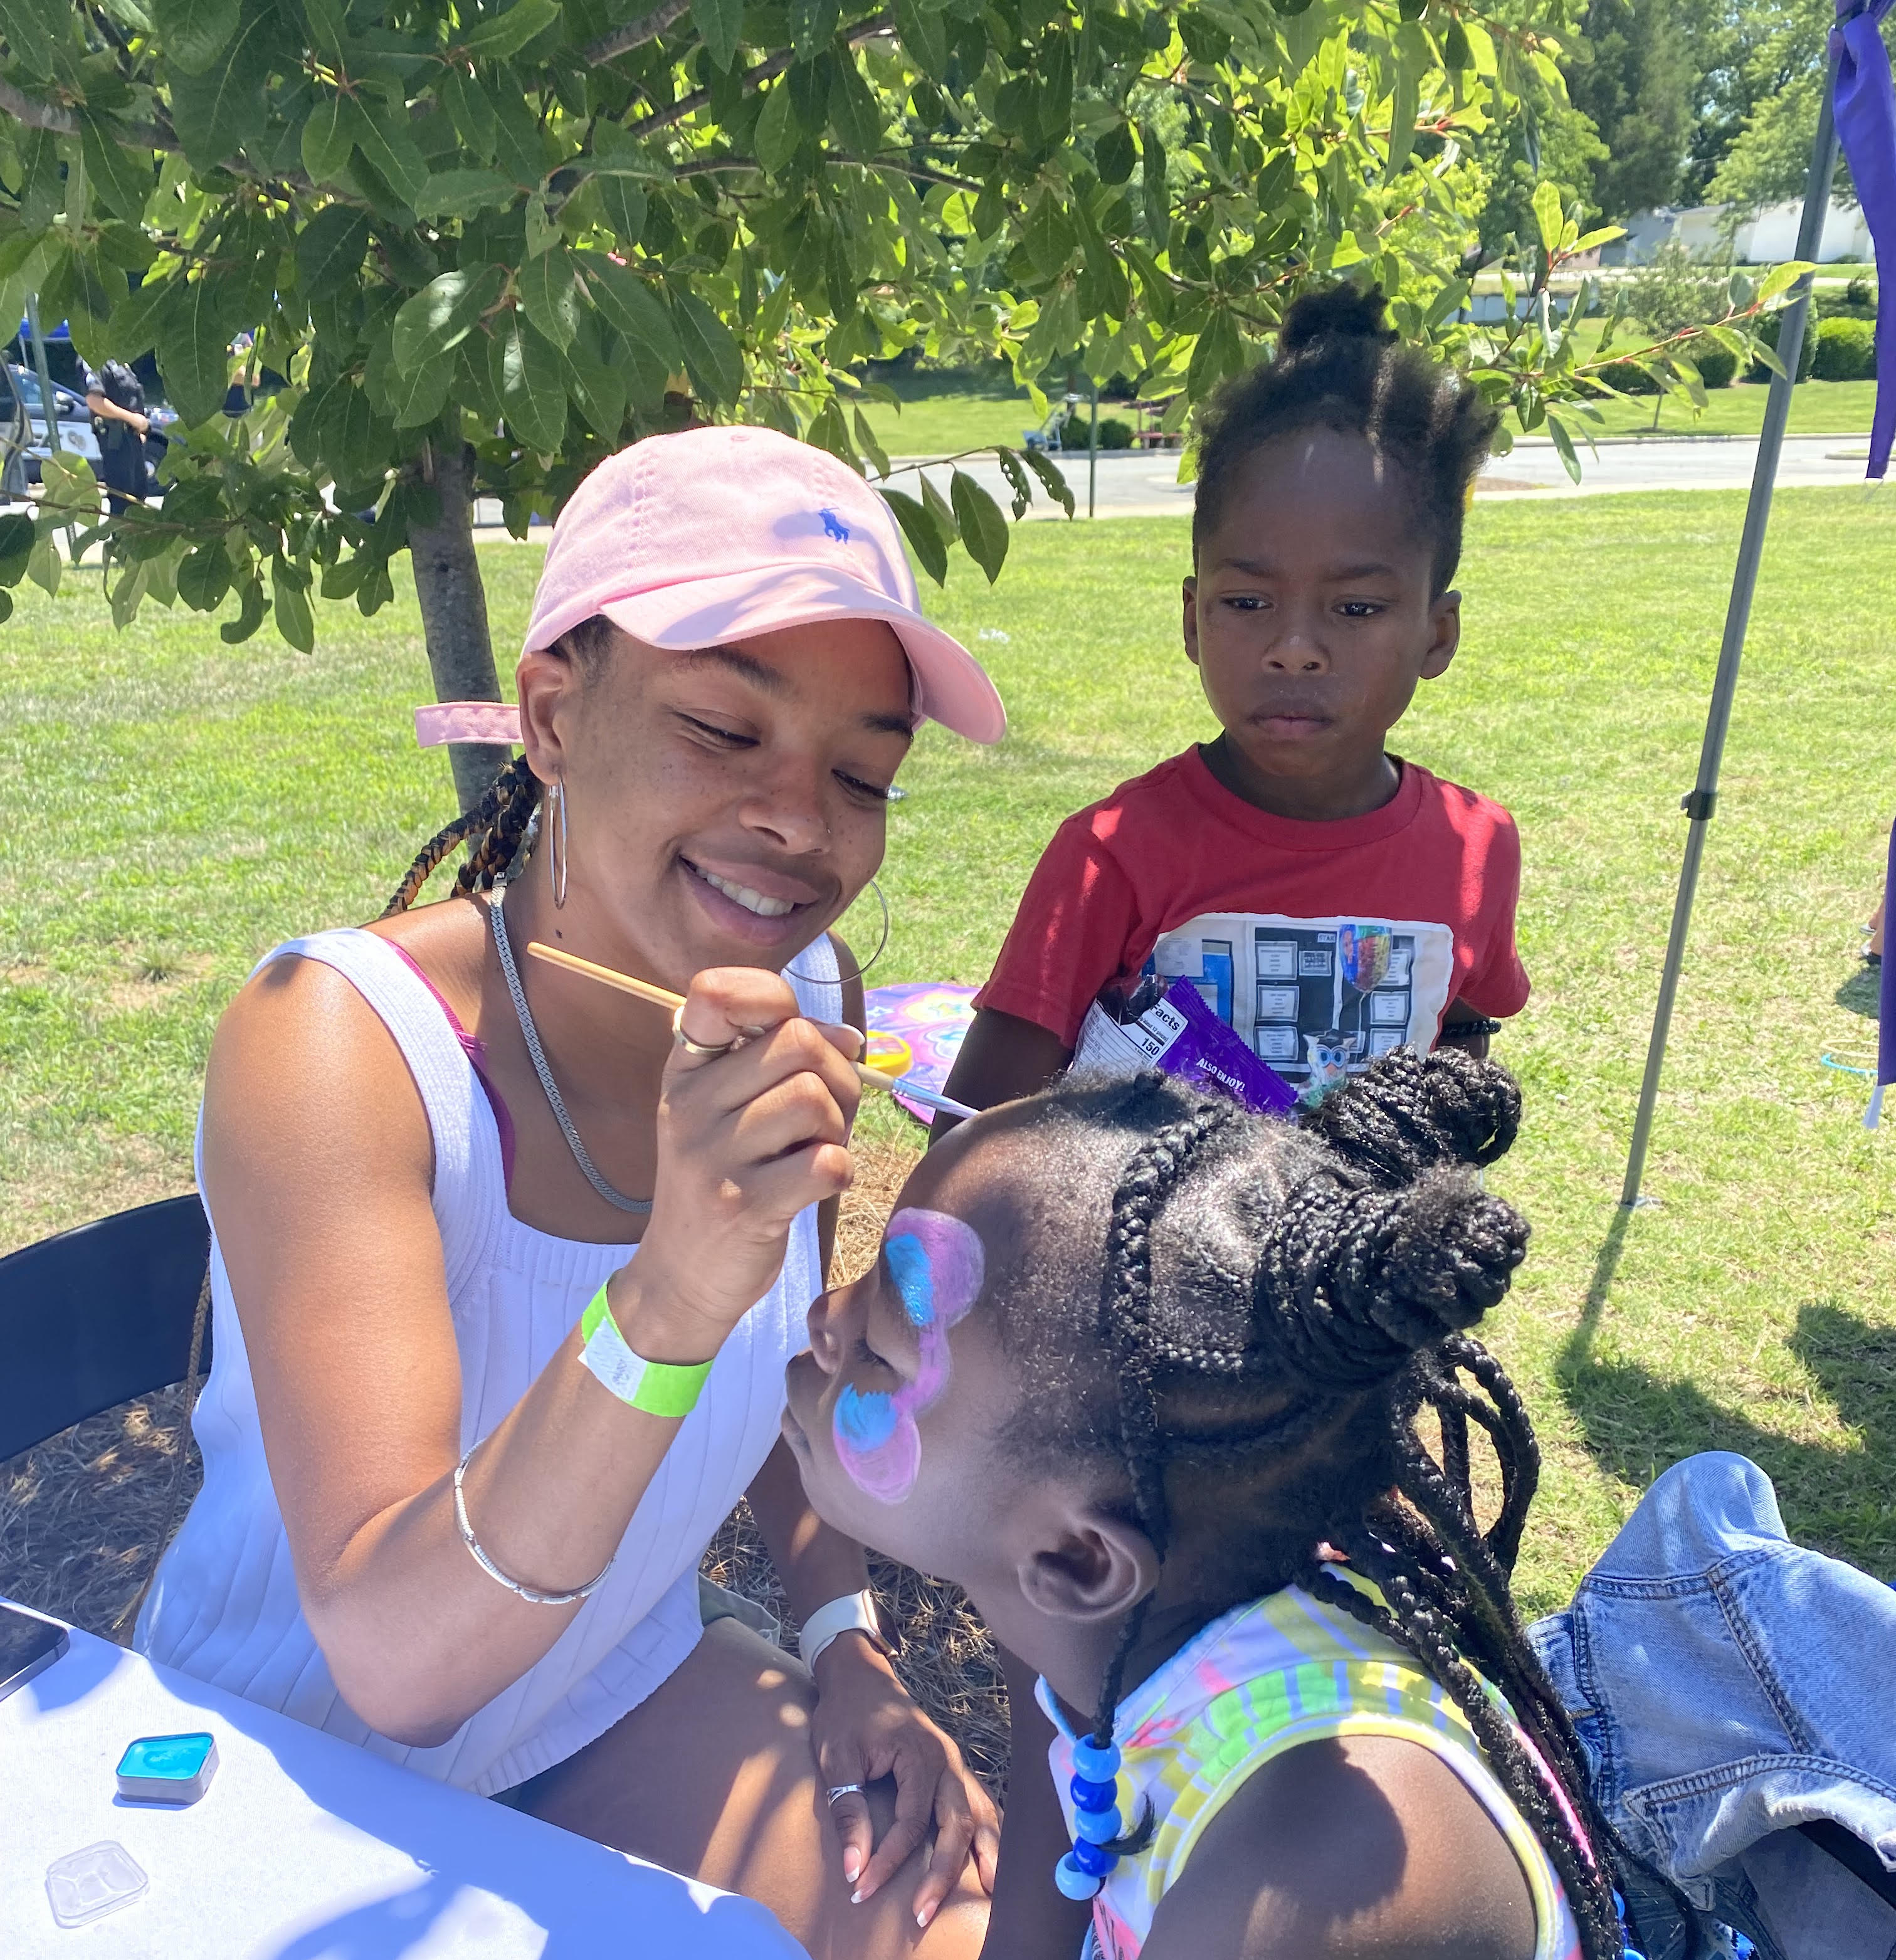
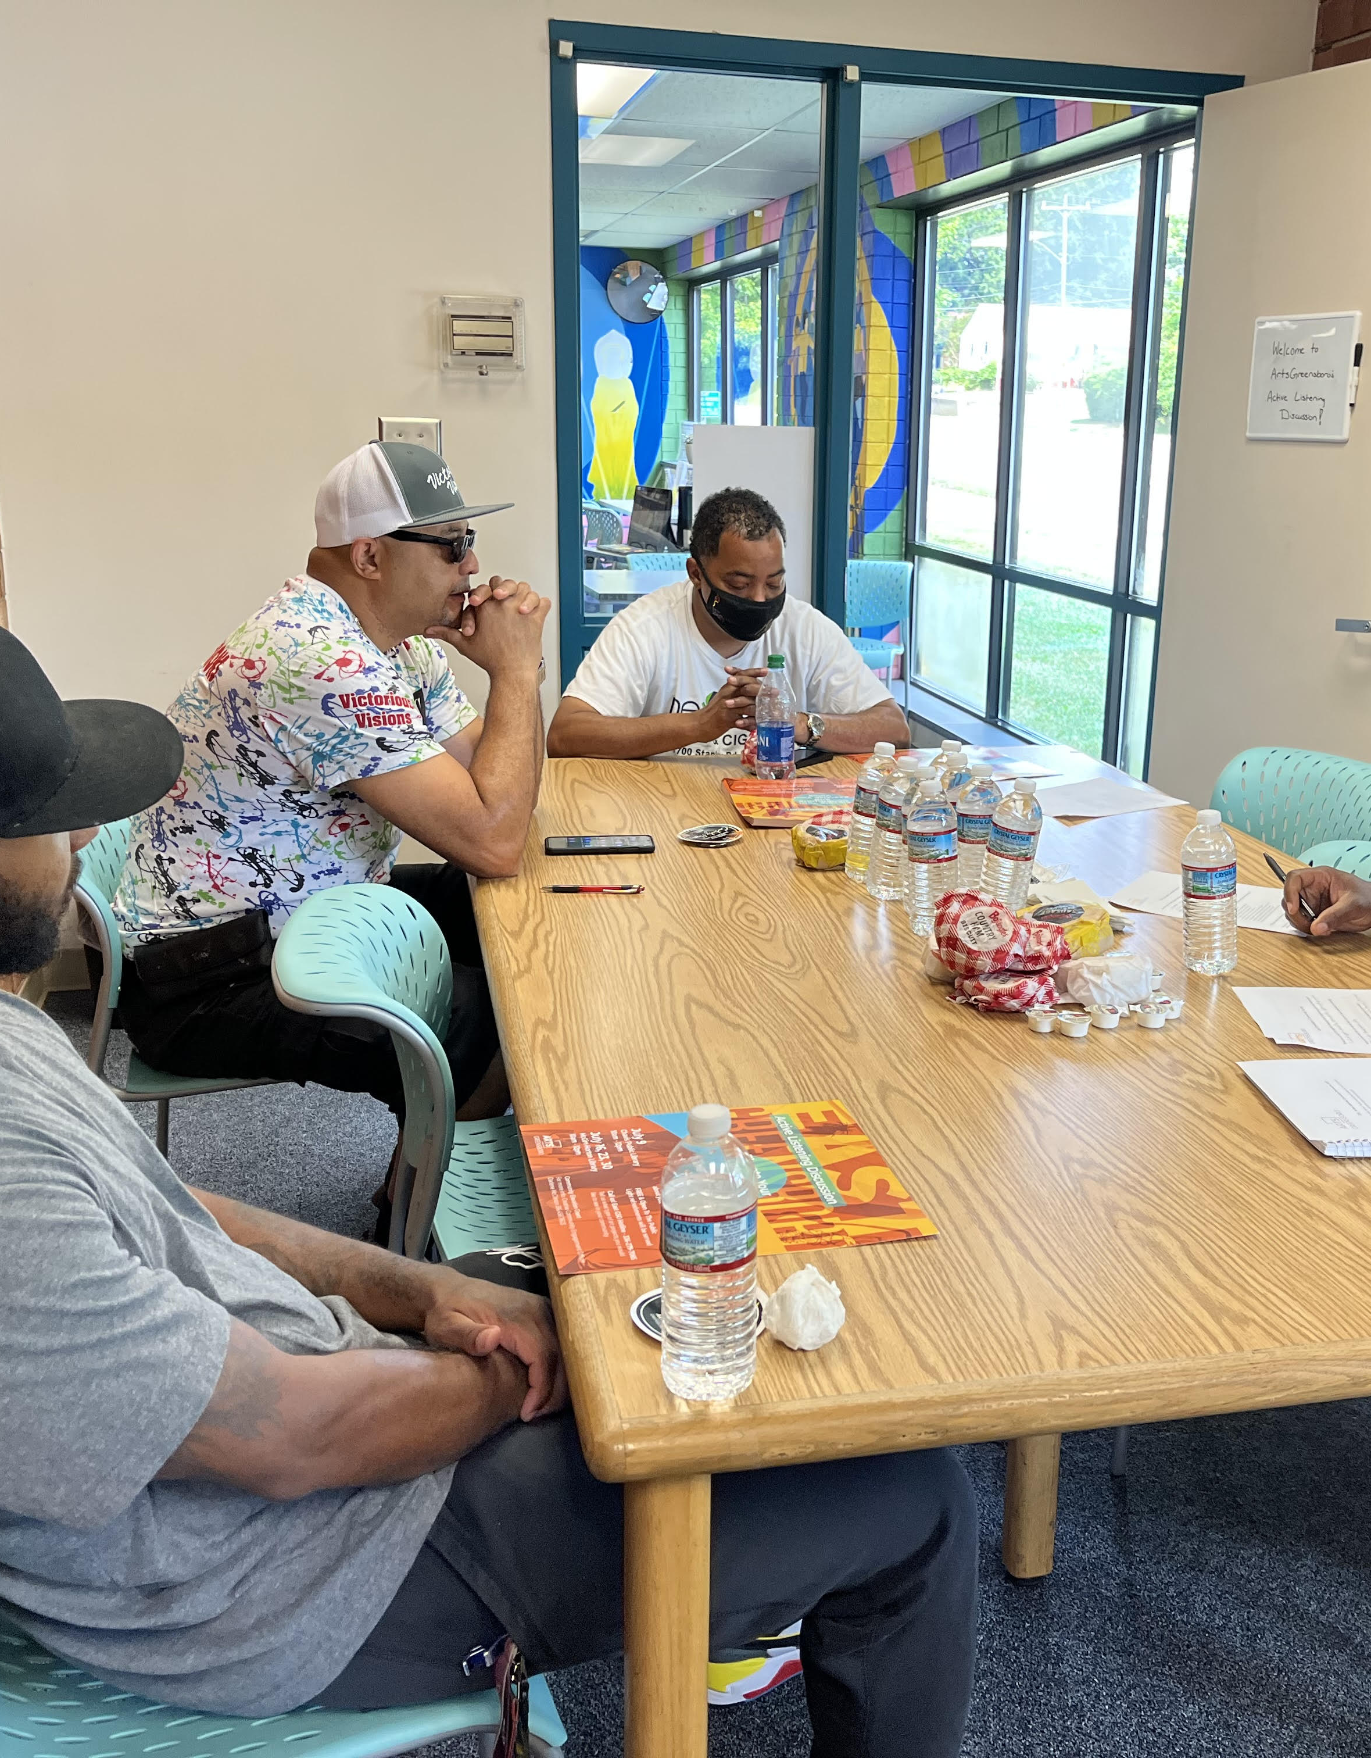
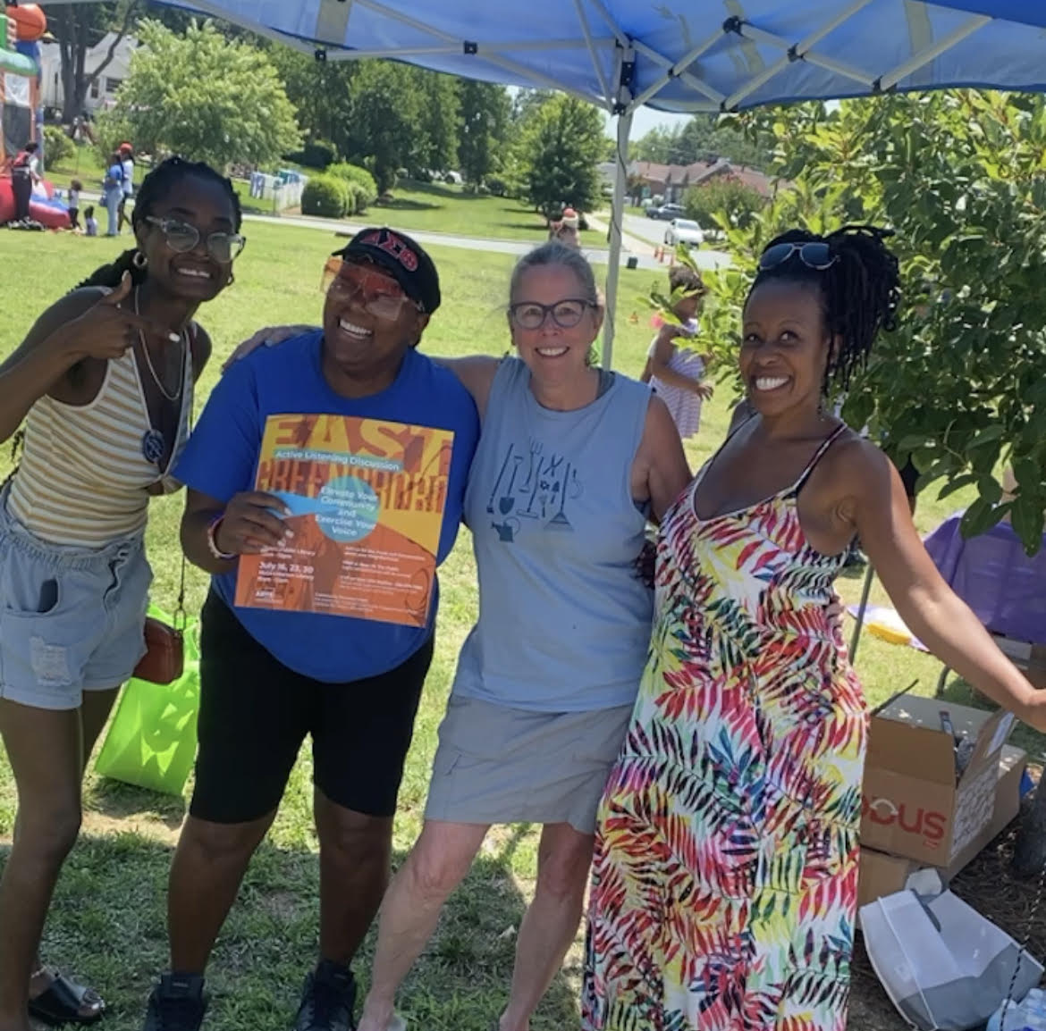
QUESTIONS?

